Slide 1
Chapter 21 Database Recovery Techniques

Slide 2
Recovery Concepts
Recovery Outline and Categorization of Recovery Algorithms
Recovery from transaction failures usually means that the database is restored to the most recent consistent state before the time of failure.
The system keeps information about the changes that were applied to data items by the various transactions in the system log.

Slide 3
Recovery Concepts
Recovery Outline and Categorization of Recovery Algorithms
If there is extensive damage to a wide portion of the database such as a disk crash, the recovery method restores a past copy of the database and reconstructs a more current state by redoing the operations of committed transactions from the backed-up log, up to the time of failure.

Slide 4
Recovery Concepts
Recovery Outline and Categorization of Recovery Algorithms
When the database on disk is not physically damaged, the recovery strategy is to identify any changes that may cause an inconsistency in the database.
For example, a transaction that has updated some database items on disk but has not been committed needs to have its changes reversed by undoing its write operations.
It may also be necessary to redo some operations in order to restore a consistent state of the database; for example, if a transaction has committed but some of its write operations have not yet been written to disk.

Slide 5
Recovery Concepts
Recovery Outline and Categorization of Recovery Algorithms
Deferred update techniques: do not physically update the database on disk until after a transaction commits.
Before reaching commit, all transaction updates are recorded in the local transaction workspace or in the main memory buffers that the DBMS maintains.
Before commit, the updates are recorded in the log file on disk, and then after commit, the updates are written to the database from the main memory buffers.

Slide 6
Recovery Concepts
Recovery Outline and Categorization of Recovery Algorithms
If a transaction fails before reaching its commit point, it will not have changed the database on disk in any way, so UNDO is not needed.
It may be necessary to REDO the effect of the operations of a committed transaction from the log, because their effect may not yet have been recorded in the database on disk.
Deferred update is also known as the NO-UNDO/REDO algorithm.

Slide 7
Recovery Concepts
Recovery Outline and Categorization of Recovery Algorithms
Immediate update techniques: the database may be updated by some operations of a transaction before the transaction reaches its commit point.
These operations must also be recorded in the log on disk by force-writing before they are applied to the database on disk, making recovery still possible.
If a transaction fails after recording some changes in the database on disk but before reaching its commit point, the effect of its operations on the database must be undone.
This technique, known as the UNDO/REDO algorithm, requires both operations during recovery and is used most often in practice.

Slide 8
Recovery Concepts
Caching (Buffering) of Disk Blocks
The recovery process: based on the buffering of database disk pages(block) in the DBMS main memory cache.
DBMS cache: Collection of in-memory buffers.
A directory for the cache is used to keep track of which database items are in the buffers.
Directory entries:
<Disk_page_address,Buffer_location, … >

Slide 9
Recovery Concepts
Caching (Buffering) of Disk Blocks
DBMS requests action on some item:
First it checks the cache directory to determine whether the disk page containing the item is in the DBMS cache.
If it is not, the item must be located on disk, and the appropriate disk pages are copied into the cache.
Replace (or flush) some of the cache buffers to make space available for the new item, if buffer if filled.

Slide 10
Recovery Concepts
Caching (Buffering) of Disk Blocks
Dirty bit: Associated with each buffer in the cache which can be included in the directory entry to indicate whether or not the buffer has been modified.
Dirty bit is set to 0 (zero): page is first read from the database disk into a cache buffer, a new entry is inserted in the cache directory with the new disk page address.
Dirty bit set to 1 (one): As soon as the buffer is modified.
When the buffer contents are replaced (flushed) from the cache, the contents must first be written back to the corresponding disk page only if its dirty bit is 1.

Slide 11
Recovery Concepts
Caching (Buffering) of Disk Blocks
Pin-unpin bit: page in the cache is pinned (bit value 1 (one)) if it cannot be written back to disk as yet.
For example, the recovery protocol may restrict certain buffer pages from being written back to the disk until the transactions that changed this buffer have committed.
Before image (BFIM):the old value of the data item before updating.
After image (AFIM): the new value after updating.

Slide 12
Recovery Concepts
Write-Ahead Logging, Steal/No-Steal, and Force/No-Force
REDO-type log entry includes the new value (AFIM) of the item written by the operation since this is needed to redo the effect of the operation from the log.
UNDO-type log entries include the old value (BFIM) of the item since this is needed to undo the effect of the operation from the log.
In an UNDO/REDO algorithm, both BFIM and AFIM are recorded into a single log entry.

Slide 13
Recovery Concepts
Write-Ahead Logging, Steal/No-Steal, and Force/No-Force
DBMS cache holds the cached database disk blocks in main memory buffers.
When an update to a data block—stored in the DBMS cache—is made, an associated log record is written to the log buffer in the DBMS cache.
Write-ahead logging approach: the log buffers (blocks) that contain the associated log records for a particular data block update must first be written to disk before the data block itself can be written back to disk from its main memory buffer.

Slide 14
Recovery Concepts
Write-Ahead Logging, Steal/No-Steal, and Force/No-Force
No-steal approach: a cache buffer page updated by a transaction cannot be written to disk before the transaction commits.
UNDO will never be needed during recovery, since a committed transaction will not have any of its updates on disk before it commits.
pin-unpin bit will be set to 1 (pin) to indicate that a cache buffer cannot be written back to disk.
Steal: the recovery protocol allows writing an updated buffer before the transaction commits.

Slide 15
Recovery Concepts
Write-Ahead Logging, Steal/No-Steal, and Force/No-Force
Force approach: If all pages updated by a transaction are immediately written to disk before the transaction commits.
REDO will never be needed during recovery, since any committed transaction will have all its updates on disk before it is committed.
Otherwise, it is called no-force.
For frequently changed objects, a no-force policy reduces the number of write operations to the on-disk database object.

Slide 16
Recovery Concepts
Write-Ahead Logging, Steal/No-Steal, and Force/No-Force
The deferred update (NO-UNDO) recovery scheme follows a no-steal approach.
Typical database systems employ a steal/no-force (UNDO/REDO) strategy.
The advantage of steal is that it avoids the need for a very large buffer space to store all updated pages in memory.
The advantage of no-force is that an updated page of a committed transaction may still be in the buffer when another transaction needs to update it.

Slide 17
Recovery Concepts
Write-Ahead Logging, Steal/No-Steal, and Force/No-Force
Write-ahead logging (WAL) protocol for a recovery algorithm that requires both UNDO and REDO:
The before image of an item cannot be overwritten by its after image in the database on disk until all UNDO-type log entries for the updating transaction have been force-written to disk.
The commit operation of a transaction cannot be completed until all the REDO-type and UNDO-type log records for that transaction have been force written to disk.

Slide 18
Recovery Concepts
Checkpoints in the System Log and Fuzzy Checkpointing
Another type of entry in the log is called a checkpoint.
A [checkpoint, list of active transactions] record is written into the log periodically at that point when the system writes out to the database on disk all DBMS buffers that have been modified.
All transactions that have their [commit, T ] entries in the log before a [checkpoint] entry do not need to have their WRITE operations redone in case of a system crash, since all their updates will be recorded in the database on disk during checkpointing.

Slide 19
Recovery Concepts
Checkpoints in the System Log and Fuzzy Checkpointing
The interval may be measured in time every m minutes or in the number t of committed transactions since the last checkpoint:
1.Suspend execution of transactions temporarily.
2. Force-write all main memory buffers that have been modified to disk.
3. Write a [checkpoint] record to the log, and force-write the log to disk.
4. Resume executing transactions.

Slide 20
Recovery Concepts
Checkpoints in the System Log and Fuzzy Checkpointing
The time needed to force-write all modified memory buffers may delay transaction which is not acceptable in practice.
Fuzzy checkpointing.
The system can resume transaction processing after a [begin_checkpoint] record is written to the log without having to wait for step 2 to finish.
When step 2 is completed, an [end_checkpoint, … ] record is written in the log with the relevant information collected during checkpointing

Slide 21
Recovery Concepts
Transaction Rollback and Cascading Rollback
If a transaction fails for whatever reason after updating the database, but before the transaction commits, it may be necessary to roll back the transaction.
If any data item values have been changed by the transaction and written to the database on disk, they must be restored to their previous values (BFIMs).
The undo-type log entries are used to restore the old values of data items that must be rolled back.

Slide 22
Recovery Concepts
Transaction Rollback and Cascading Rollback
If a transaction T is rolled back, any transaction S that has, in the interim, read the value of some data item X written by T must also be rolled back.
Similarly, once S is rolled back, any transaction R that has read the value of some data item Y written by S must also be rolled back; and so on.
This phenomenon is called cascading rollback, and it can occur when the recovery protocol ensures recoverable schedules but does not ensure strict or cascadeless schedules.

Slide 23
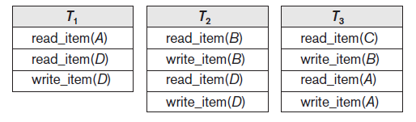
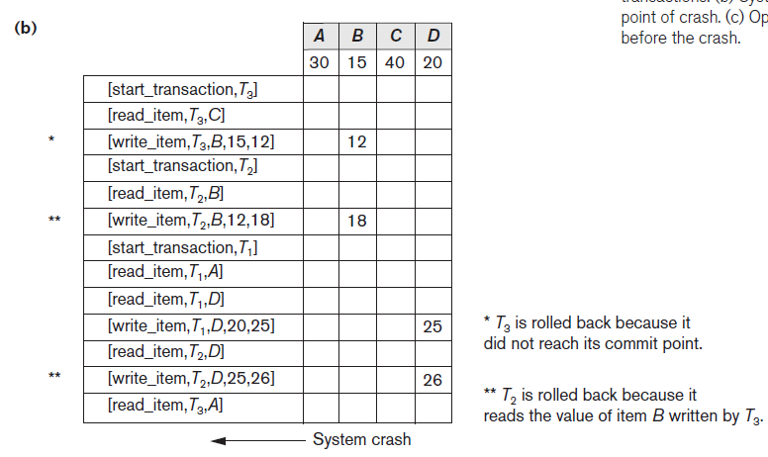
Recovery Concepts
Transaction Rollback and Cascading Rollback

Slide 24
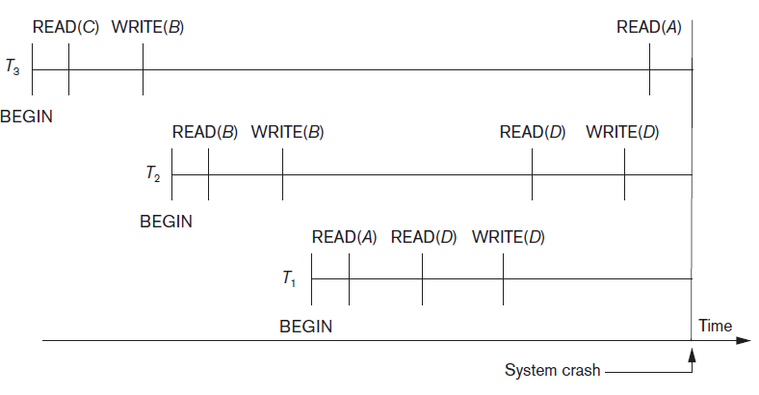
Recovery Concepts
Transaction Rollback and Cascading Rollback

Slide 25
Recovery Concepts
Transaction Rollback and Cascading Rollback
We must now check for cascading rollback.
T2 reads the value of item B that was written by transaction T3.
Because T3 is rolled back, T2 must now be
rolled back, too.
The WRITE operations of T2, marked by ** in the log, are the one that are undone.
Note that only write_item operations need to be undone during transaction rollback; read_item operations are recorded in the log only to determine whether cascading rollback of additional transactions is necessary.

